Slide 1
SOEN 6441
WARZONE BUILD-3
Team 13
Jayati Thakkar 40230506
Sushant Sinha 40261753
Raj Kumar Ramesh 40225218
Bhoomi Bhatt 40291067
Rupal Kapoor 40274905
Rikin Chauhan 40269431

Slide 2
SYSTEM FLOW OVERVIEW
Goal of the Build: The aim of our project is to create an advanced strategy game engine that allows players to compete in a virtual world.
Architectural Design :
We have structured our system using the Adapter and Strategy design patterns to ensure flexibility, modularity, and efficient event tracking.
The Strategy pattern is used keeping in mind the Open/Closed Principle and Single Responsibility Principle for a class
The Strategy patter is employed for handling behavior of player types such as Aggressive, Benevolent, Cheater, Human and Random
The Adaptor pattern is integrated for game loading and saving the game, based on the type of file loaded, i.e. Domination or Conquest

Slide 3
REFACTORING AND DESIGN
Refactor code using the Adapter pattern: Adapter pattern ensures the loading and saving from and to a file using the “conquest” game map.
This pattern helps decide to use either the original “domination” file reader or the “conquest” file reader adapter, when a file is opened, depending on the file type.
Any exceptions thrown while reading the file are handled by SaveMapAdapter and never thrown to the Game Controller
Refactor code using the Strategy Pattern: The Strategy pattern is used to implement the different player behaviors, where the strategies provide varying behavior that support the Player class to expose varying behavior
This ensures different implementation based on the behavior of the players
The PlayerStrategy class is designed such that exceptions thrown while reading the file are handled and never thrown to the Game Controller

Slide 4
ARCHITECTURAL DESIGN

Slide 5
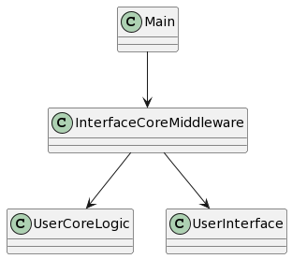
Main Driver classes

Slide 6
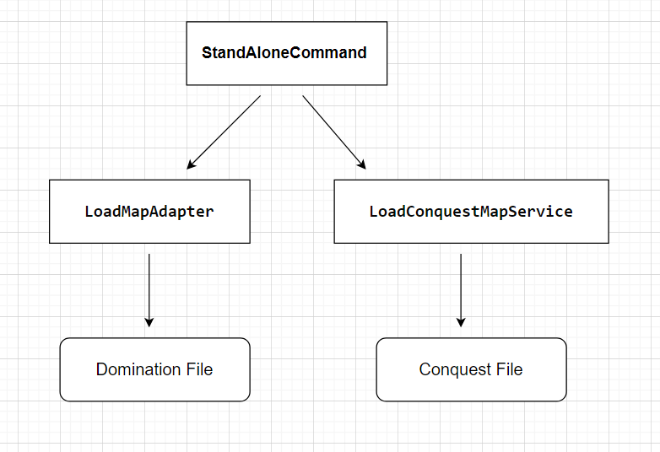
Adapter pattern

Slide 7
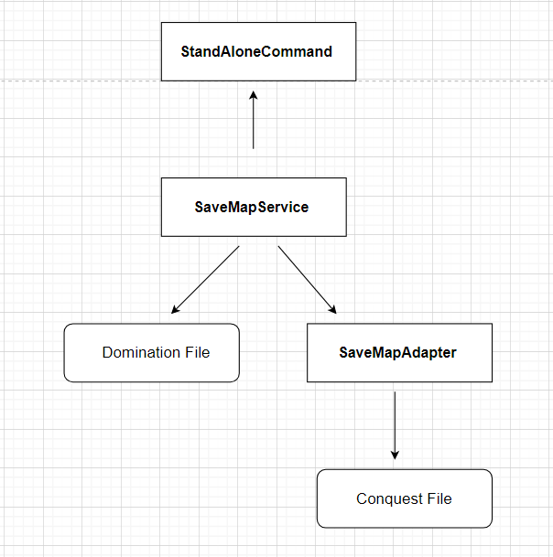

Slide 8
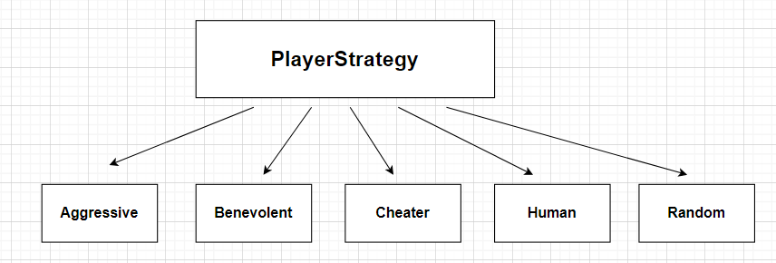
Strategy pattern

Slide 9
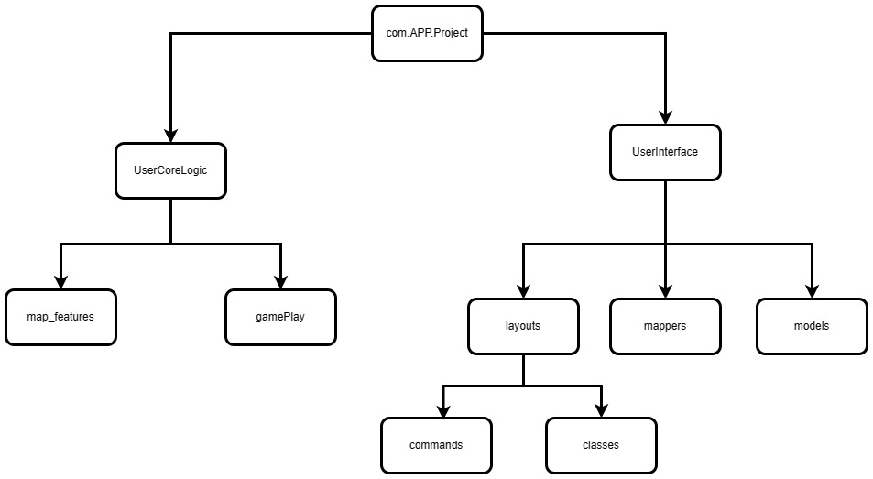

Slide 10
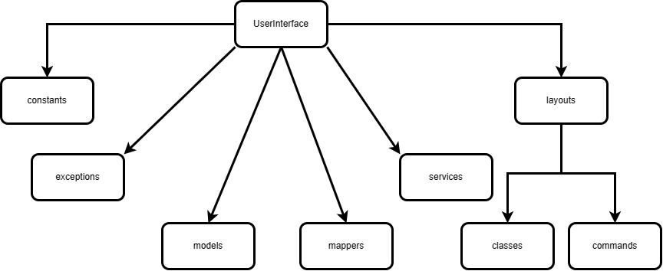

Slide 11
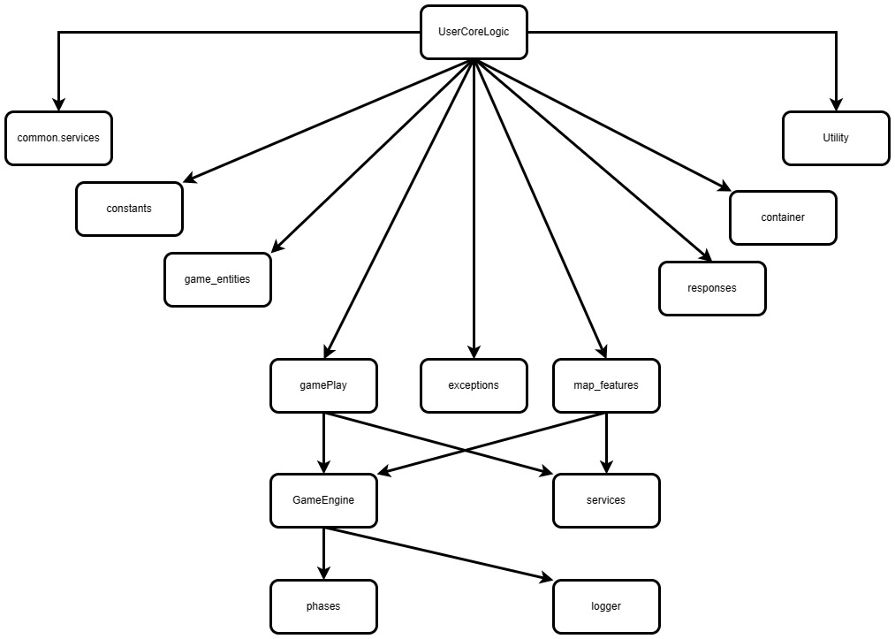

Slide 12
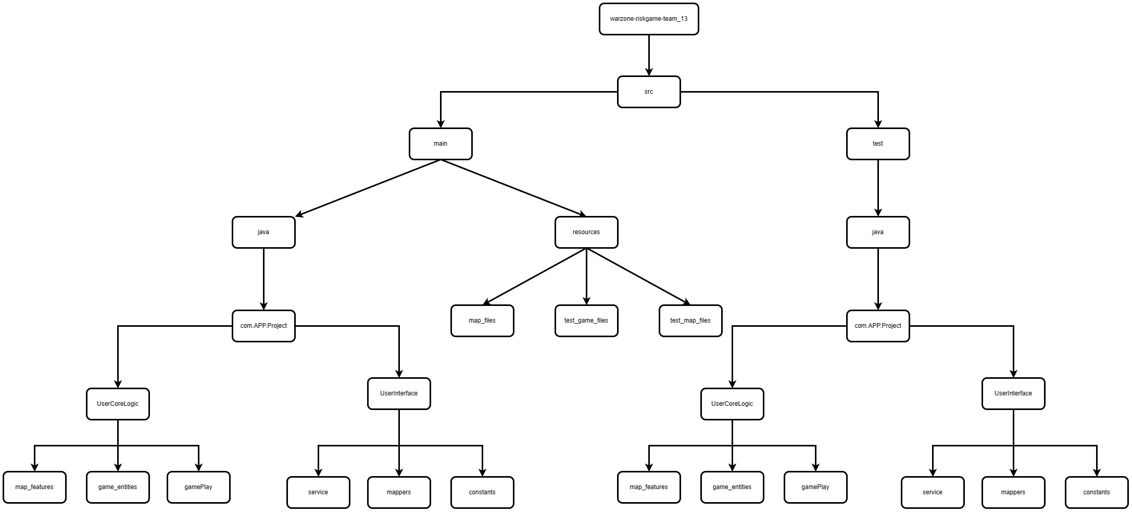

Slide 13
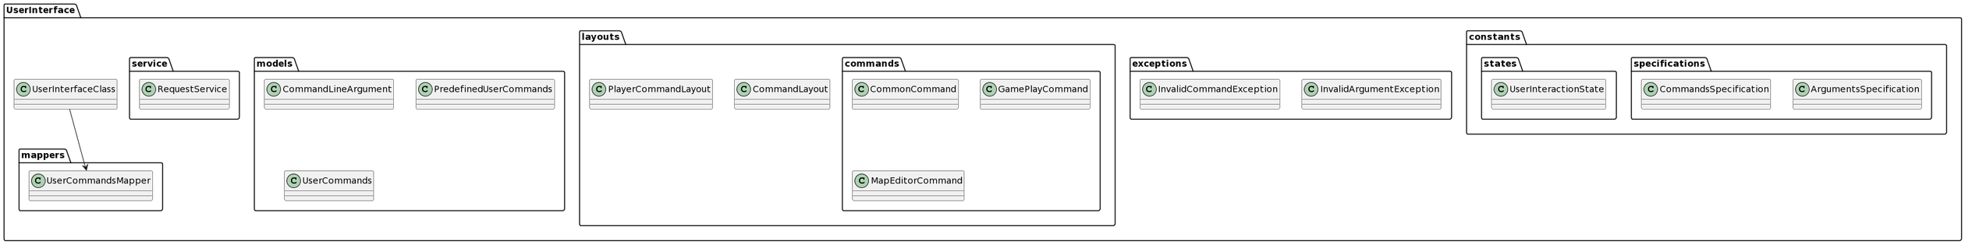
USER INPUTS AND CLASS HANDLING

Slide 14
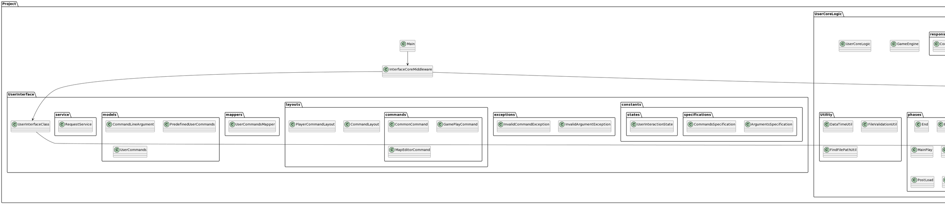
Core Logic

Slide 15
TOOLS USED
IntelliJ IDE
GitHub
JavaDoc
JUnit

Slide 16
Snapshots

Slide 17
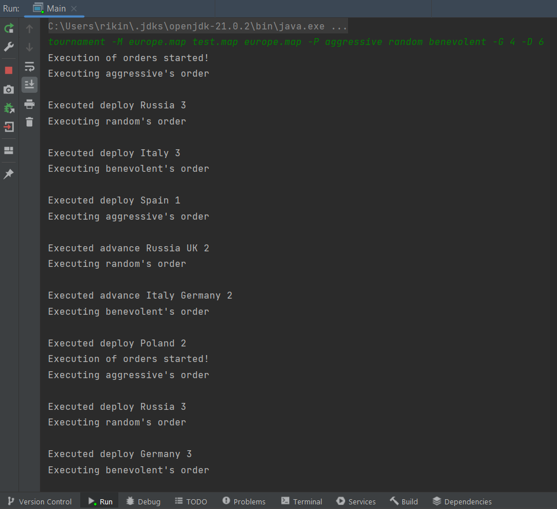

Slide 18
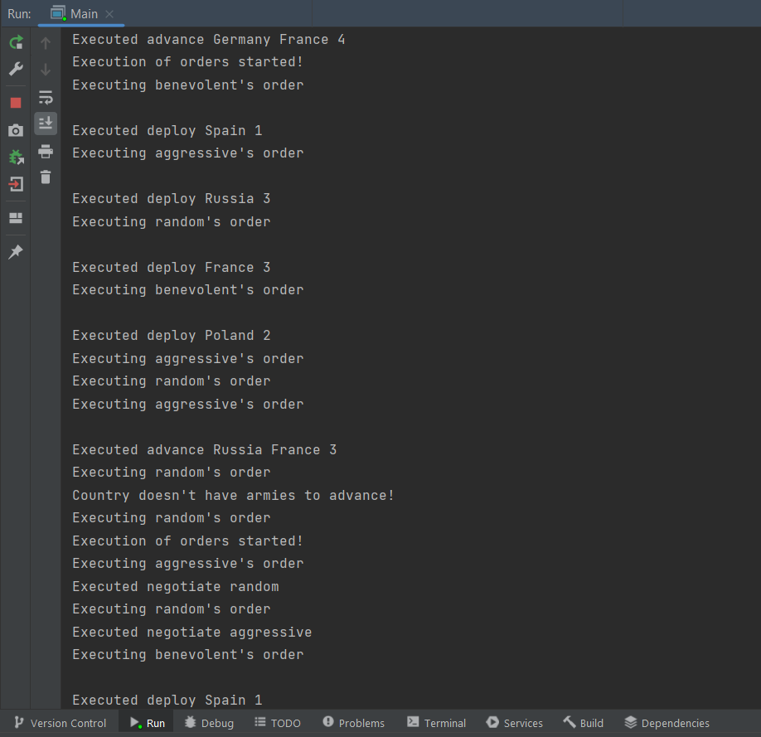

Slide 19
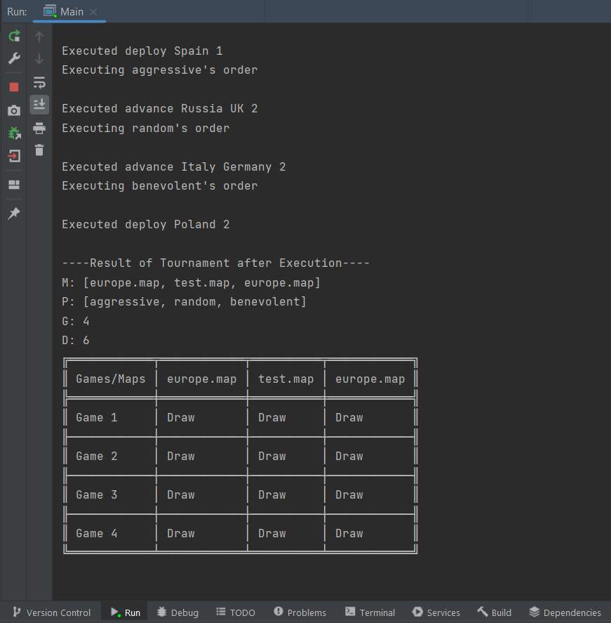

Slide 20
Thank you!

